Slide 1

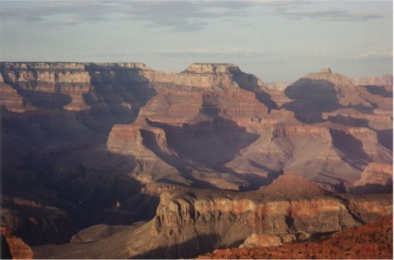
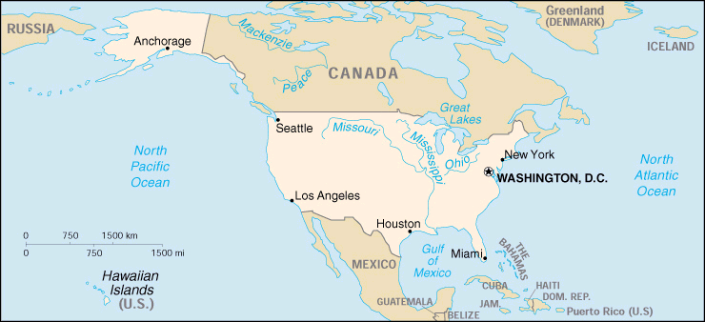
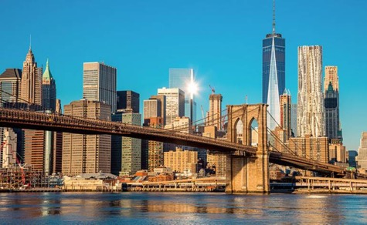
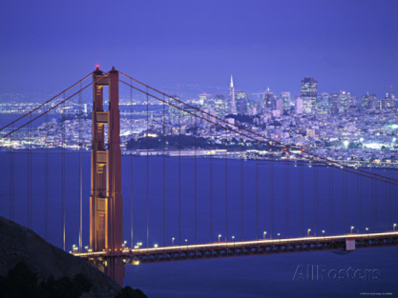
ISA April 2022 Country Report
United States

Slide 2
United States: Key Facts
Overview:
Key Facts and Data:
The United States stands as the world’s most powerful country, maintaining massive economic, political, military and cultural influence throughout the world.
The original 13 US states won their independence from Great Britain at the end of the 18th century and the country gradually expanded westwards until reaching the Pacific Ocean.
As the US became the world’s leading economic power, it remained politically isolated until its involvement in the two World Wars in the first half of the 20th century.
Today, the United States is essentially a two-party democracy, with the Republican and Democratic parties dominating US politics.
The United States has been heavily involved in all areas of the world, with its recent involvement in the conflicts of the Middle East causing a great deal of controversy.
The United States is the richest of the world’s major economic powers, although it has greater wealth inequalities than many other developed countries.
Official Name
United States of America
Capital
Washington
Government Type
Federal republic
Head of State and Government
President Joe Biden (since 2021)
Population
334,805,000
Land Area
9,158,960 sq. km
Total GDP (US$)
$22.9 trillion
Per Capita GDP at PPP (US$)
$68,309
Currency
US dollar

Slide 3
Table of Contents
Current Events:
Economic Outlook:
Recent Political Events
Recent Economic Events
Other Recent Events
Economic Overview
GDP Growth Forecasts
Key Sector Forecasts
Inflation Forecasts
Foreign Trade Forecasts
Foreign Investment Forecasts
Exchange Rate Forecasts
Outlook for Key Sector
Key Economic Issues
Economic Risk Outlook
Political Outlook:
Overview of the Current Government
Leadership Profile
Summary of the Most Recent Elections
Leading Political Parties
Forecast for the Next Elections
International Relations Outlook
Potential Conflicts
Military Capabilities
Key Political Issues
Political Risk Outlook
Demographic & Environmental Outlook:
Population Overview
Population Characteristics
Development of Leading Urban Centers
Key Demographic Issue
Topography and Climate Overview
Environmental Threat Summary
Key Environmental Issues
Demographic and Environmental Risk Outlook

Slide 4
Current Events and Recent Changes Overview

Slide 5
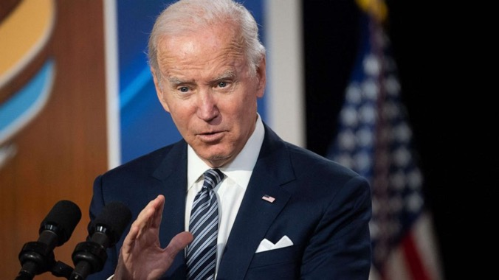
United States: Recent Political Events and Changes
Key Political Events and Changes:
In the wake of the Russian invasion of Ukraine, President Biden ordered US troops in Europe to be deployed in East European NATO member states, while sending more troops from the US to Europe. In addition, President Biden announced a range of new US economic sanctions against Russia. However, President Biden ruled out US military forces being sent to Ukraine.
After botching the United States’ withdrawal from Afghanistan last year, the Biden Administration’s handling of the Russian invasion of Ukraine was largely lauded. President Biden was credited with uniting the West and other US allies against Russia, while keeping the US out of the conflict so far. It remains to be seen if his handling of this crisis will boost his relatively low approval ratings.
It was reported that people smugglers from Mexico had penetrated new sections of the border wall between the United States and Mexico on at least 3,272 occasions over the past three years, using only standard hardware to cut through the wall. Critics have charged that the border wall championed by former President Donald Trump would do nothing to slow the flow of migrants into the United States.

Slide 6
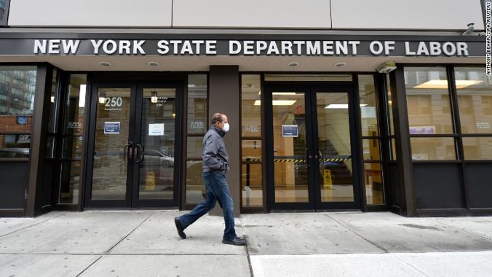
United States: Recent Economic Events and Changes
Key Economic Events and Changes:
The United States economy expanded by a better-than-expected 7.0% on an annualized basis in the fourth quarter of 2021. This growth was driven by a major increase in private sector inventories and continued strong growth in consumer spending. For the year in 2021, the US economy expanded by 5.7%.
The annual inflation rate in the United States rose to 7.9% in February 2022, its highest level in 40 years. Higher costs for energy, food and housing were the catalysts for this high rate of inflation. Furthermore, rising gas prices are expected to add to the inflationary pressures facing the US in the coming months.
The US Federal Reserve raised interest rates by 25 basis points to 0.50% in March 2022, its first interest rate hike since 2008.
The United States job market remained very strong in the early part of this year, creating 678,000 new jobs in February 2022 In addition, it was revealed that the number of new jobs created in the US over the previous two months was also much higher than initially reported. As a result, the unemployment rate in the US fell to a two-year low of just 3.8% as labor shortages remained acute.

Slide 7
United States: Other Recent Events and Changes
Other Key Events and Changes:
The total number of Covid-19 cases recorded in the United States surpassed the 81 million mark in March 2022, while the official number of deaths from Covid-19 in the US surpassed one million.
After soaring earlier this year, the number of new Covid-19 cases in the United States began to trend sharply downwards in February and March 2022.
Over the past twelve months, 1.7 million migrants from 160 different countries were stopped at the US-Mexican border, the highest number ever recorded. More than one million of these migrants have already been returned to their home countries, mostly in Central America.

Slide 8
United States Political Outlook

Slide 9
United States: Current Government
Overview:
Key Members of the Government:
Joe Biden was sworn in as the 46th president of the United States in January 2021.
President Trump’s cabinet is noteworthy, both for its diversity and for the fact that it contains a large number of officials who were a part of Barack Obama’s government between 2009 and 2017.
The fact that a large number of well-known government officials are included in the Biden Administration highlights the fact that President Biden has moved to delegate a good deal of authority to his team.
Head of State
President Donald Trump
Vice President
Mike Pence
Secretary of State
Anthony Blinken
Secretary of the Treasury
Janet Yellen
Attorney General
Merrick Garland
Secretary of Homeland Security
Alejandro Mayorkas
Secretary of Defense
General Lloyd Austin
Secretary of the Interior
Deb Haarland
Secretary of Health and Human Services
Xavier Becerra

Slide 10
Profile of President Joe Biden
Background:
After a long and distinguished career in politics, Joe Biden became president of the United States at the age of 78 in 2021, becoming the oldest person to assume that position.
Joe Biden became a US Senator from the state of Delaware at the age of 30 in 1972, and he served in the Senate for the next 36 years.
He ran unsuccessfully on two occasions for the Democratic Party’s nomination for the presidency of the United States, in 1988 and 2008.
In 2009, he became Vice President of the United States, working closely with President Barack Obama for the next eight years.
Key Policies and Stances:
A good deal of President Biden’s political career has been focused on the issues of foreign policy and security.
After becoming president, he moved quickly to restore relations with the United States’ closest allies in the wake of the Trump presidency.
President Biden has also focused a good deal of his attention on bringing some of the internal divisions that have arisen in the United States.
This includes efforts to combat racism and sexism in the US and efforts to reduce the widening level of wealth inequality with the US.

Slide 11
United States: Most Recent Elections Presidential Elections – November 2020
Summary of the Last Elections:
Results by State and County:
Former Vice President Joe Biden won a relatively clear victory over incumbent President Donald Trump in 2020’s presidential election.
On election night, it appeared that President Trump could be about to win a surprising victory, but mail-in ballots overwhelmingly favored Mr. Biden.
In the end, Biden defeated President Trump by a margin of 306 to 232 in the Electoral College, and by more than six million votes nationally.
Biden won five states (Pennsylvania, Michigan, Georgia, Arizona and Wisconsin) that had been won by President Trump in 2016.
In the weeks after the election, President Trump and most of his Republican allies refused to concede defeat, claiming widespread electoral fraud.
The Trump Administration launched a series of legal challenges in a number of states, but each of these challenges failed.
The president’s refusal to concede defeat was viewed by many as a challenge to the United States’ democratic norms.
Red – Trump
Blue - Biden

Slide 12
United States: Most Recent Elections Congressional Elections – November 2020
Summary of the Last Elections:
Control of the Congress:
November 2020’s mid-term elections in the United States were expected to produce some major Democratic gains in the Congress.
However, the Republicans did significantly better than had been expected and had been predicted by most pre-election polls.
In the Senate, the Democrats had been given a strong chance to win control of that body, but their hopes were left hanging by a thread in two run-off elections in Georgia.
In the House of Representatives, Republican candidates scored a number of victories, thus reducing the Democrats majority in that body.
Republican voters came out in larger numbers than had been expected, with Republican turn out boosted by higher-than-forecast levels of support for President Trump.
Despite this, the Democrats still managed to score a few impressive victories and will look to 2022’s mid-term elections as their chance to make more gains in the Senate.
Source: US Federal Election Commission

Slide 13
United States’ Leading Political Forces: Democratic Party
History:
Dating from Thomas Jefferson in the late 18th century, the Democratic Party moved to the political and economic left in the 20th century.
Today, the party encompasses a number of left and center elements.
The Democrats trail the Republicans among white and male voters, but hold a sizeable lead among minority and female voters.
Key Policies and Stances:
Source: US Federal Election Commission
The Democrats are generally in favor of greater government intervention in the economy.
The Democrats are more in favor of a cautious foreign policy and working with international organizations.
The party supports a number of issues favored by the country’s minorities as much of its support comes from minority groups.
Outlook:
The Democrats regained control of the presidency in 2020’s presidential election, but failed to make as many gains in the Congress as had been expected.
Furthermore, the party lost some of its share of the vote among minority voters in the US, a segment that had been expected to strengthen the Democrat’s chances in future elections.

Slide 14
United States’ Leading Political Forces: Republican Party
History:
Until 2008, the Republican Party had held the presidency of the United States for 94 of the last 146 years.
After eight years out of power, the Republican Party was in turmoil, beset by infighting and ideological differences.
Now, following President Donald Trump’s one term in office, the party faces many questions about its future direction and leadership.
Key Policies and Stances:
Source: US Federal Election Commission
The Republicans are in favor of lower taxes and less government interference in the economy.
Traditionally more isolationist in foreign affairs, many segments of the party now push for a more aggressive foreign policy.
Many segments of the party are very socially conservative, hence the party’s success in the South and the Great Plains.
Outlook:
The Republican party has consolidated its gains in rural areas of the country and among some segments of the voting population.
However, the Trump years ushered in some dramatic changes for the party, and it remains to be seen if these changes will be temporary or not.

Slide 15
United States: International Relations Outlook
Key International Disputes:
The United States remains the world’s dominant military power, but it is facing a number of challenges to its power in key regions such as East Asia.
In recent years, the US has focused more of its attention on Asia as it moves to lessen its presence in Europe and the Middle East.
The rise of China is the greatest single threat to US power since the fall of the Soviet Union.
International Relations Outlook:
The United States’ rebalancing towards Asia will result in closer ties with countries such as Japan and Australia and the expense of traditional allies in Europe and the Middle East.
Nevertheless, the US’ continued military dominance will require US involvement in nearly all areas of the world in the coming decades.

Slide 16
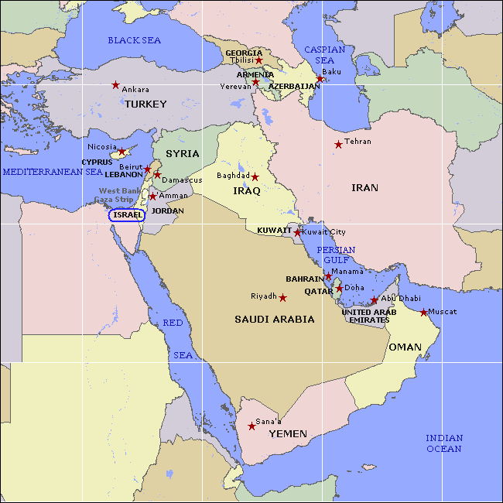
Potential Conflict: The Middle East Region
Main Disputes:
While the United States has reduced its military presence in the Middle East in recent years, it retains enough military assets in the region to guarantee the balance of power there.
The US continues to play a leading role in preventing Iranian influence from spreading throughout the region.
The United States’ continued support for Israel has cost it much support among the Arab populations of the region.
The civil war in Syria and the unrest in many areas of the region has led to increasing calls for the US to become more involved in the region’s multitude of conflicts.
Best- and Worse-Case Scenarios:
Best Case Scenario
The United States lessens its presence in the region and the balance of power is able to hold.
Worst-Case Scenario
Escalating conflicts in the region force the US military to become more involved in the region once again.

Slide 17
Potential Conflict: North Korea
Main Disputes:
Both countries want unification of the Korean Peninsula, but on their own terms.
North Korea’s missile and nuclear weapons programs have raised the stakes in this ongoing dispute.
North Korea’s increasingly dire economic situation raises the threat of desperate action.
North Korea opposes the presence of US troops in South Korea.
Timeline
1945 – The Korean Peninsula is split in two by the United States and the USSR after World War Two.
1950 - North Korea invades South Korea, leading to US and Chinese involvement in the Korean War.
1953 - An armistice ends the fighting in the Korean War.
1994 - North Korea withdraws from the IAEA.
2002 - North Korea admits nuclear weapons program.
2006 - North Korea carries out its first nuclear test.
2010 - North Korea sinks a South Korean naval vessel and shells a South Korean island.
2012 – Kim Jung-il dies and is replaced by his young son, Kim Jung-un.
2017 – North Korea carries out a series of nuclear and missile tests.
2018 – The leaders of the US and North Korea meet.
Best- and Worse-Case Scenarios:
Best Case Scenario
The North Korean government is peacefully overthrown, allowing for a reunification of the Korean peninsula.
Worst-Case Scenario
North Korea invades South Korea or carries out a nuclear strike, leading to a devastating war that kills millions on the Korean Peninsula and perhaps Japan.

Slide 18
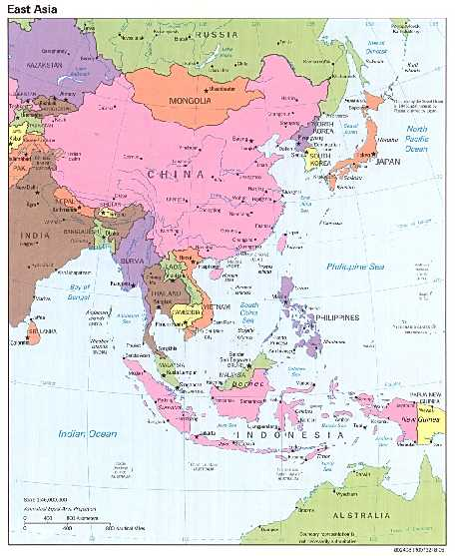
Potential Conflict: Asia
Main Disputes:
China has clearly emerged as the largest economic and military rival to the United States in the Asia-Pacific region.
The United States’ military ties with countries that have major disputes with China (Japan, Taiwan, etc.) have grown in recent years.
The US could find itself involved in conflicts in South Asia, Indonesia and Central Asia, all involving China.
Best- and Worse-Case Scenarios:
Best Case Scenario
The United States is able to maintain significant forces in the region, forcing more aggressive powers to hold back their territorial ambitions.
Worst-Case Scenario
China’s growing assertiveness with its neighbors leads to a conflict involving the United States and China.

Slide 19
The Quad A Four-Member Counter-Balance to China
Summary
The Quadrilateral Security Dialogue (”the Quad”) is an informal dialogue between the United States, India, Japan and Australia that was founded in 2007 at the behest of the Japanese government.
In subsequent years, the Quad lost some momentum, and even came to a temporary end when former Australian President Kevin Rudd withdrew Australia from the group in 2010 as part of his efforts to strengthen his country’s ties with China.
In 2017, the Quad was revived as all four members had conservative governments that were concerned about China’s rising economic and military power in the Indo-Pacific region. In 2021, the four leaders of the Quad group of countries held their first-ever official summit (virtually, due to the Covid-19 pandemic).
The United States, Japan and Australia have long had strong economic and defense ties, but India has traditionally been leery of forming tighter economic and defense ties with the US. However, clashes between Chinese and Indian armed forces along the two countries’ shared border have pushed India closer to the United States and its allies in the region.
The size and scale of the Quad has the potential to make the group one of the most influential groupings in the world. The four countries of the Quad account for 35% of global economic output and 46% of global defense spending.
Outlook for the Quad
As China’s economic and military power continues to grow in the coming years, India is likely to push for a further strengthening of the Quad. Furthermore, other regional powers may consider efforts to join the Quad due to fear of China’s rising power and influence.

Slide 20
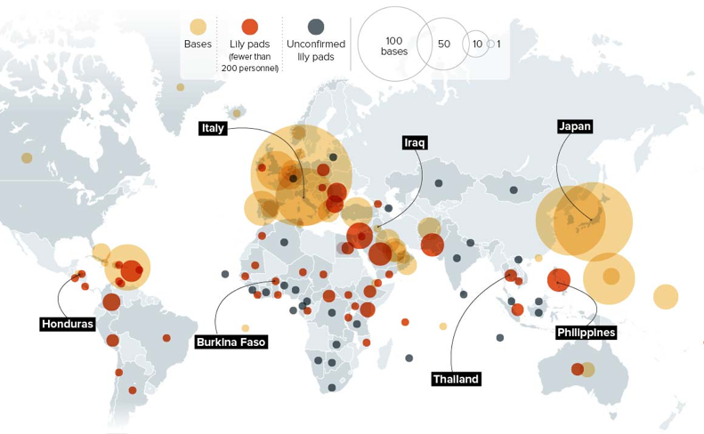
Key Foreign Policy Issue (part one): The Danger of US Isolationism
Introduction - For the past century, the United States has been the dominant player in global affairs and it has used its dominant position to enforce a liberal political and economic order on much of the world. After its entry in the First World War turned the tied against the Axis powers, the United States emerged as the world’s economic powerhouse. In the Second World War, the United States, together with its Soviet, British and other allies, ended the imperial ambitions of Germany and Japan, allowing a liberal and capitalist order to dominate much of Europe and Asia. Finally, the US’ “victory” in the Cold War resulted in much of the rest of the world being integrated into a US-led economic, trade and investment system that brought unprecedented growth to many formerly isolated areas of the world. While the United States has made many mistakes in its position of global leadership, its role as the primary enforcer of peace in Europe and Asia, and its protection of the world’s leading trade routes, resulted in decades of remarkable growth in terms of economic output as well as international trade and investment.
A History of Isolationism
Prior to its ascendancy to the top of the global power table during the Second World War, much of the United States’ history was dominated by a desire to remain isolated from the problems of the rest of the world. While defending its role as the dominant power in the Western Hemisphere for the past 200 years, the US had largely remained aloof from problems further afield and even when it was dragged into far-away conflicts, as during the First World War, it quickly retreated back into isolationism. For many, this isolationism allowed the United States to concentrate on the development, modernization and expansion of the US economy, something that resulted in the US becoming the world’s dominant economy many decades before it became the world’s leading political and military power. This nostalgia for a bygone era when the United States was effectively shielded by two vast oceans from the rest of the world’s problems is a key component of the renewed desire by many US voters to have the country return to a sort of 21st century isolationism. This is evident by the surprisingly strong support for this year’s Republican candidate for the US presidency, Donald Trump, who’s call for a massive wall along the Mexican border and a withdrawal from the US’ defense commitments to many of its overseas allies harkens back to the heady days of US isolationism in the 19th century or the 1920s.
United States Overseas Military Bases

Slide 21
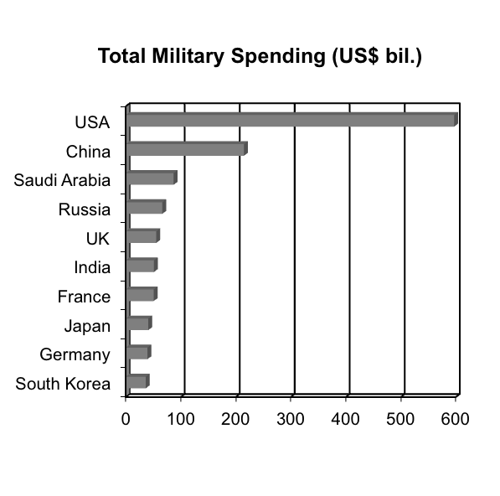
Key Foreign Policy Issue (part two): The Danger of US Isolationism
Focusing on Home
Polls taken in recent years have shown that there is a clear trend towards more support for a lesser role for the United States in global affairs among US voters. The endless wars in the Middle East and Central Asia, coupled with what many people in the United States see as the negative impact of the US’ trade and investment partnerships with foreign countries, have led to greater support for politicians such as Donald Trump that call for the US to focus on internal affairs, rather than on issues and threats overseas. Already, many of the recent trade deals that the United States has been at the forefront of, such as the TPP (with the Pacific Rim) and the TTIP (with the European Union), not to mention the 22-year-old NAFTA trade deal, are in jeopardy as an increasing number of voters in the US are opposed to many aspects of these deals and blame them for the loss of manufacturing jobs in the US. Moreover, the United States’ extensive military commitments in all regions of the world are also being questioned, as more and more areas of the world grow increasingly unstable. Altogether, political, security and economic trends are combining to convince many US voters that their country should turn inward, regardless of the implications.
The Danger of a US Withdrawal
Unfortunately for the United States and the rest of the world, the US remains the indispensible country when it comes to maintaining the liberal trade and investment order that dominates the world economy, as well as the military alliances that have preserved peace in Europe and Asia in recent decades. On the economic front, a turn towards isolationism in the world’s largest economy would lead to many of the world’s other leading economic powers also turning towards protectionism. This would cause massive disruptions to global trade and investment and lead to the greatest economic crisis since the Great Depression. On the political and security front, a collapse of US-led defense alliances in Europe and Asia would encourage revisionist powers such as Russia and China to use force to defend their territorial claims in the former Soviet Union (for Russia) and in the waters of the western Pacific Ocean (for China). Moreover, no single power would be in a position to take the United States’ place as the power guaranteeing trade, investment and security in the key economic centers of the world, leading to significantly higher levels of conflict risk around the world. As such, a turn towards isolationism in the United States would worsen, rather than enhance, the prospects for security and economic growth in the US and around the world, making the US and the world a much more dangerous place.

Slide 22
Military Spending
Strengths and Weaknesses
No single country in history enjoyed the scale of military superiority over the entire world as the United States did in the wake of the end of the Cold War.
Today US military budget is larger than the next nine-most powerful countries combined.
Moreover, the US military enjoys a huge technological lead over all of its rivals.
With its dominant naval and air power, the United States can project power anywhere in the world.
The biggest risk to the US military at present is being stretched too thinly due to its role in conflicts around the world.
US armed forces have major commitments in the Middle East, Central Asia and East Asia.
Source: SIPRI
Outlook
The United States’ lead in military power has grown dramatically over most other developed economies.
Only China’s military power is growing at a faster rate and it still lags far behind the US in terms of technology, naval forces and air power.

Slide 23
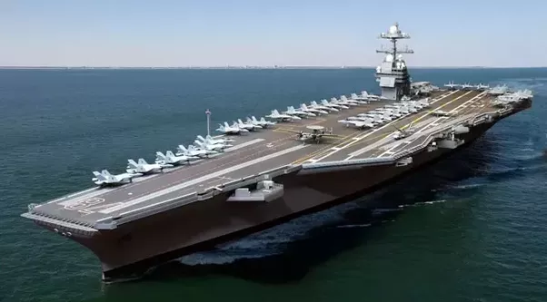
Key Defense Issue (part one): How Long Will the US Rule the Seas?
Summary - Of all of the measures of military power in which the United States is the world’s leading country, it is in the field of naval power in which the US has perhaps its greatest lead over all other countries. In terms of land power, the US has the world’s most powerful land forces, but the gap between it and rivals such as China and Russia is not as great on land as it is in the air or the sea. In terms of air power, the US has a formidable array of planes and systems designed to give the US air superiority in any potential conflict, but even here, its power advantage is not as great as it is at sea. At sea, the US navy currently has no rival and is able to both dominate the open seas and to control most of the world’s most important shipping lanes. Since the United States gained control of the seas during the Second World War, its lead in terms of naval power over rival navies has continued to expand. Moreover, even as other countries such as China and India invest heavily in their naval forces, the US’ massive lead in this area is set to remain in place for a very long time. Nevertheless, internal and external threats could emerge that could weaken the US’ dominance of the seas over the longer term.
No Competition, For Now
It is easy to understate the level of dominance that the United States possesses at sea. Its naval budget alone exceeds that of all of its major rivals’ combined naval expenditures, and its fleet of aircraft carriers, cruisers, destroyers, submarines and other naval vessels not only dwarfs its rivals in terms of numbers, but also in terms of firepower and technology. One example of this is the fact that the United States has ten of the world’s 20 active aircraft carriers, with each individual US carrier having the firepower of three or four of its rivals. In addition, the US Navy possesses 75% of the world’s cruisers, 50% of the world’s nuclear submarines and 30% of the world’s destroyers. Add to this array of weaponry a favorable geographic position that gives the US open access to all of the world’s oceans and it is clear that the US is operating from a position of overwhelming strength at sea. In addition, its main rivals suffer from distinct geographical disadvantages, such as China’s location behind multiple series of island chains and Russia’s lack of warm water ports, further enhancing the US’ naval advantages.

Slide 24
Key Defense Issue (part two): How Long Will the US Rule the Seas?
Boosting Trade and Investment
While many countries bristle at the thought that the United States’ domination of the world’s waterways has provided massive benefits for their citizens, there is no doubt that the dominance of the world’s oceans by a single power has allowed for many of the advances in living standards and security that the world enjoys today. First, as an economically liberal country, the United States has supported the rise of global trade and investment (at least until this year) and has allowed trade and investment to flourish by protecting the world’s most important shipping lanes. With a major naval presence near all of the world’s leading shipping lanes, the US Navy allowed the modern globalized economy to flourish, and provided a means for emerging markets to export their way to greater prosperity and for aging developed economies to continue to grow through exporting to more dynamic markets. This, in turn, boosted business and investor confidence by ensuring that global trade would not be disrupted by unrest and conflict along these vital arteries of commerce. Furthermore, the US navy’s domination of the seas has prevented lawlessness at sea, at least in areas where the United States has a direct interest in preventing such lawlessness.
Economic Impact
While many countries bristle at the thought that the United States’ domination of the world’s waterways has provided massive benefits for their citizens, there is no doubt that the dominance of the world’s oceans by a single power has allowed for many of the advances in living standards and security that the world enjoys today. First, as an economically liberal country, the United States has supported the rise of global trade and investment (at least until this year) and has allowed trade and investment to flourish by protecting the world’s most important shipping lanes. With a major naval presence near all of the world’s leading shipping lanes, the US Navy allowed the modern globalized economy to flourish, and provided a means for emerging markets to export their way to greater prosperity and for aging developed economies to continue to grow through exporting to more dynamic markets. This, in turn, boosted business and investor confidence by ensuring that global trade would not be disrupted by unrest and conflict along these vital arteries of commerce. Furthermore, the US navy’s domination of the seas has prevented lawlessness at sea, at least in areas where the United States has a direct interest in preventing such lawlessness.
A Future Rival?
There is no doubt that the United States’ massive advantage in terms of naval power will remain in place for the foreseeable future. The US’ current partners (and potential rivals) in Europe have seen their naval power fall dramatically over the past century and, given their declining share of global defense spending, Europe’s relative naval power is set to continue to decline in the coming decades. Likewise, Russia’s navy remains largely a token force, although its submarines do possess one of the few threats to the US Navy in some areas of the world. Of all of the potential rivals to the US at sea, only one, China, appears likely to close the gap with the United States in terms of naval power. This is due to the fact that China is spending more than any other country outside of the US on its navy and is developing naval forces aimed at both controlling the seas adjacent to China as well as being able to project power much further abroad. This is likely to lead to a battle for influence and position, both in bodies of water near China (such as the South China Sea) as well as along shipping lanes further abroad (such as in the Pacific and Indian oceans). Certainty, it will take a long time for China to develop a navy capable of challenging the US’ dominance at sea, but it appears likely that this is China’s intention, at least in the areas in which China has major trading and investment interests. Should a true rival emerge and find itself at odds with the US Navy, global trade and investment could suffer a major setback.

Slide 25
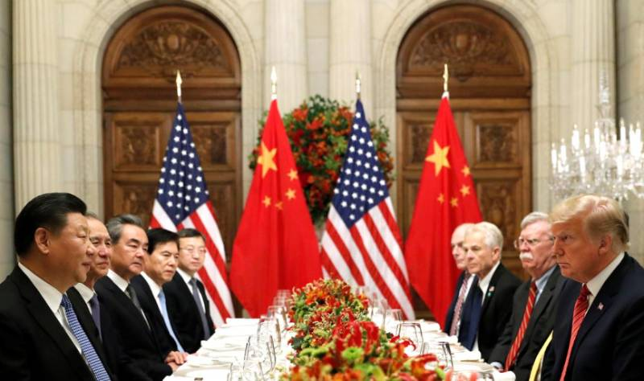
Geopolitical Issue in Focus (part one): The Global Balance of Power in 20 Years
Introduction - In the field of geopolitics, projecting the global balance of power at some distant point in the future is a favorite exercise for many who work in this field. Over the years, many geopolitical experts have made or broken their reputation on their predictions for the balance of power in the years to come. We too have made many predictions on the global balance of power since the beginning of this century, and, so far, many of them have come true. In this case, we are going to look at the potential balance of power in the not too distant future, in fact, just 20 years into the future to be exact.
A Look Back 20 Years
To do so, we are first going to look back 20 years to assess how the global balance of power has evolved since 1999. Then, the United States was still in the midst of its post-Cold-War unipolar moment when it stood alone as the sole superpower surrounded by a number of weaker middle powers. However, it was already becoming apparent in 1999 that the US’ complete dominance of nearly all forms of power (economic, political, military, etc.) was likely to come to an end in the following decades. By 1999, China had rebounded from the political unrest of ten years earlier and was almost two-thirds of the way through its 30-year period of 10%-per-year economic growth. In Europe, the European Union was launching the euro and seeking some way to regain some of that continent’s lost strategic independence. Around the world, emerging markets, some of them with very large populations and territories, were becoming enmeshed in the global economy and were beginning to have aspirations of greater power for themselves.
A Familiar Balance of Power
The balance of power in 2019 would not be too unfamiliar to someone from 1999 looking at the world today, with a few notable exceptions. The United States still remains the world’s leading power by most measures of power, and its lead over its primary rivals for power throughout the previous century has, for the most part, expanded. However, a new rival to the US’ longer-term position atop the global balance of power has emerged, China. In fact, China’s overall level of power now dwarves that of nearly all other countries around world, apart from the United States. In fact, from the unipolar moment that existed in 1999, the world today appears increasingly like a bipolar world, dominated by two giant superpowers.

Slide 26
Geopolitical Issue in Focus (part two): The Global Balance of Power in 20 Years
Other Powers
Outside of the US and China, the balance of power among the world’s middle powers is also shifting. Europe has struggled over the past 20 years, both in terms of its economic stagnation and its struggle to unify the region in a bid to allow it to play a greater role in global affairs. In contrast, India has made great strides over the past 20 years, but due to its poverty and internal divisions, is a long way from challenging the US and China. Russia has rebounded from a decade of dissolution and chaos during the 1990s to once again play a major political and military role in world affairs, but its economic and demographic weaknesses have prevented Russia from effectively challenging the two leading powers. Finally, emerging markets outside of Asia such as Brazil and Mexico had hoped to play a larger role in the global balance of power, but have been thwarted by their economic troubles in recent years.
The Economic Aspect
As we look ahead to the global balance of power in twenty years’ time, there are some key trends that we need to watch due to their potential impact on the world’s leading powers. One of these key trends is the outlook for economic growth, as apart from Asia, economic growth rates have been trending downwards over the past few decades. If China and India can maintain higher rates of economic growth than the US and other powers, their relative power to the US and others will continue to rise. If not, the US may be able to hold on to its leading position well into the latter part of the 21st century. Another factor to watch is the shift in economic and technological power to Asia. Since the late 18th century, economic and technological power has been centered in the West, first in Europe and then, for the past century or more, in North America. By 2039, Asia’s combined economic output will be significantly larger than that of the West, while more and more technological advances are likely to spring from that region.

Slide 27
Geopolitical Issue in Focus (part three): The Global Balance of Power in 20 Years
Key Trends to Watch
One trend that should be watched over the next decades is the fraying of the ties that link the individual countries of the West together, allowing the West to continue to play a dominant role in many important fields. This includes the gradual drifting apart of the United States and Europe, as well as growing internal divisions within Europe (and to a lesser degree within North America). An increasingly fragmented West would allow China and other non-Western states to enhance their position within the global balance of power in the coming years. Another factor to watch is demographics, as we are in the midst of a dramatic rebalancing of global demographic power. As birth rates plunge in the West, East Asia and in many other parts of the world, many of the leading world powers 20 years from now will have to deal with dramatic declines in their working-age populations, as well as having much older populations than they have today. In contrast, populations will continue to soar in many of the poorest parts of the world, especially in Sub-Saharan Africa, where the population will rise by more than 600 million people over the next 20 years.
The US Remains the Leading Power
In 20 years, it is likely that we will be living in a world dominated by two superpowers, with a number of second-tier powers either aligning themselves with one of the superpowers or vying to compete with both of these larger powers. One of these superpowers will be the United States. In 20 years, the US is all but certain to retain either the first or the second position in nearly all of the factors that make up a state’s power. While it may no longer be the largest economy in the world in 2039, it will certainly retain the strongest military and will likely remain the world’s technological and cultural leader. Furthermore, it will almost certainly be the wealthiest large economy by a significant margin.

Slide 28
Geopolitical Issue in Focus (part four): The Global Balance of Power in 20 Years
China’s Influence Continues to Grow
The other superpower of the year 2039 will be China. By some measures, China can already be considered a superpower today, but in 20 years’ time, its rise to this status will not be disputed. Not only is China likely to have the largest economy in world at that point, but its military power will far exceed that of all other countries apart from the United States. Moreover, China’s position as the dominant power in Asia, the world’s most important region in the year 2039, will have been enhanced by 20 years of economic, military and technological growth and development. In fact, depending upon how the US-China relationship develops over the next 20 years, we could see a serious strategic rivalry between the world’s two most-powerful countries, one that is much more intense than today’s stand-off between the US and China.
Other Powers in 2039
While the US and China will be the world’s dominant powers, there are a number of other countries and entities that will also play a significant role in the world in 2039. India is one, as by the year 2039, India’s population is forecast to be more than 1.6 billion, allowing India to surpass China as the world’s most-populous country. However, even if the Indian economy averages 7% annual GDP growth over the next 20 years, its economic output will still be dwarfed by that of China and the US. Russia is another country that is likely to retain global ambitions in 20 years’ time. However, without a dramatic reversal of Russia’s demographic and economic decline, overall Russian power will be severely diminished, while its military power will fall further behind that of the US and China. The EU is another entity that has ambitions of playing a global role in the coming decades. By 2039, its economic output will be larger than all countries apart from China and the US, and it will remain a relatively wealthy region. However, internal divisions and economic and demographic decline will likely limit the EU’s ability to play a leading role in global affairs. Meanwhile, other powers such as Brazil, Indonesia, Japan and others will all maintain ambitions of playing a larger role in global affairs, but will struggle to exert much influence outside of their home regions as their overall levels of power will be far smaller than that of the United States and China.

Slide 29
Geopolitical Issue in Focus (part five): The Global Balance of Power in 20 Years
The Unknowns
While it is relatively easy to forecast the future balance of power in 20 years’ time based on the trends of the past 20 years, it is also certain that there will be unknown or unforeseen events that can dramatically shake up global affairs over the next two decades. This is clear just by looking at the surprising events of the past 20 years. For example, the 9/11 attacks in New York City greatly distracted the United States at the height of its unipolar moment and resulted in the US finding itself stuck in the quagmire of the turbulent Middle East. Likewise, the global financial crisis dealt a massive blow to developed economies, accelerating the shift of the balance of global economic power towards emerging markets. Afterwards, the rise of trade barriers and changes in economic and monetary policies in the US and elsewhere were huge blows to many emerging markets, particularly those outside of Asia. Given the number of momentous unforeseen events over the past 20 years, we can say with a high degree of certainty that more such events will take place in the coming years, events that could alter the structure of the global balance of power dramatically. These events could range from a global trade war to a conflict involving one or more of the world’s leading powers.
The World in 2039
A trend-based forecasting for the world over the next 20 years is a relatively easy exercise. For example, barring a truly earth-shattering series of events, there will be two leading powers in the world in 20 years’ time. What will be interesting to watch will be the rise and fall of the next tier of global powers. Will some of these powers rise to challenge the leading position of the US and China, or will their power continue to wane, leaving them increasingly at the mercy of the world’s two superpowers? Meanwhile, will the rivalry between the United States and China lead to a world in 2039 that looks a lot like that of the Cold War between the US and the Soviet Union, or will these two great powers learn to work together to tackle the world’s leading challenges? If trends such as the increasing support for nationalism and protectionism continue, the outlook for US-Chinese relations are likely to be grim. However, if support for globalization recovers, there is still a chance that the world in 20 years will be one of peaceful cohabitation between the world’s leading powers. These are the factors that will determine what type of world we will inhabit over the next two decades, and which global powers are driving that world in the year 2039.

Slide 30
Political Trends to Watch
Relations with China will be the key to US foreign policy in the 21st century. China’s border disputes in Asia with US allies could be a major flashpoint.
The political divide over social issues has widened and such issues will likely grow in importance over the next few years.
Foreign policy will remain in focus for the foreseeable future, as China’s rise challenges US supremacy in many areas.
The progress of free-trade agreements involving the United States have been threatened by a growing protectionist lobby.
The volatile situation in the Middle East will continue to be a focus of US attention, despite US efforts to withdraw many assets from that region.

Slide 31
United States: Security Risk
Summary
Crime-Related Risks
The United States has the highest violent crime rate of any developed country in the world.
Conflict and Stability Risks
The threat of internal conflict within the United States remains relatively low.
Political tensions have risen greatly in recent years, threatening the US’ long-term stability.
Health and Natural Risks
Health risks in the United States are quite low, but unhealthy eating and drinking habits have damaged the US’ rankings in many health-related categories.
Gun violence rates have risen in recent years, after falling for the previous three decades.
There are fears that some areas near to the United States’ southern border could experience instability.
The southeastern United States is prone to hurricanes, while earthquakes are a threat to the country’s West Coast.
Crime rates vary greatly across the United States.

Slide 32
United States: Political Risk Outlook
Current Political Risk Ratings:
Political Risk Outlook:
The United States has seen its political risk levels rise domestically, but hold relatively steady on the international front.
Internally, growing divisions (politically, socially and economically) have led to higher domestic political risk levels in recent years.
Outside of the United States, the country’s military presence in many dangerous parts of the world leaves its exposed to a relatively high level of conflict risk.
Low Risk………………High Risk
ISA Risk Ratings
0.0 to 1.9 = Low Risk
2.0 to 3.9 = Low to Moderate Risk
4.0 to 5.9 = Moderate Risk
6.0 to 7.9 = Moderate to High Risk
8.0 to 10 = High Risk

Slide 33
United States Economic Outlook

Slide 34
United States: Economic Overview
Economic Summary:
Economic Performance Comparisons:
The United States is, by a large margin, the largest economy in the world.
Moreover, the US economy has outperformed most other developed countries in recent decades in terms of growth and technological development.
The greatest threat to US economic leadership is coming from China, which is expected to overtake the US as the world’s largest economy within the next two decades.
The United States holds the leading position in a number of high-technology, future-oriented industries.
More traditional industries such as automotive and steel have not performed as well in recent decades.
In addition, the country’s economy has gradually shifted to the west and the south as investment has increasingly focused on these expanding regions.
Due to its favorable demographic situation, the United States economy has a brighter future than most other developed economies.
Moreover, its position of leadership in most high-tech industries gives the US the opportunity to avoid the long-term declines facing many other developed economies.
Size of the circle indicates the size of the economy
Avg. Annual GDP Growth 2016-2020
Source: ISA Economic Forecasts
Per Capita GDP at PPP

Slide 35
United States: Wealth Comparisons
Per Capita GDP at PPP (US$)
Key Wealth-Related Issues and Trends
The United States is easily the wealthiest large economy in the world.
Moreover, United States per capita GDP growth levels have been pulling away from other developed markets.
The US has larger wealth disparities than Europe or Japan, with more rich people in the US than anywhere else.
Source: World Bank
Thanks to the dynamism and flexibility of its economy, the US has managed to regain its wealth superiority that it had enjoyed in the first half of the 20th century. Moreover, US wealth levels are likely to grow faster than those of Europe or Japan for the foreseeable future, giving the US market much room for further expansion.

Slide 36
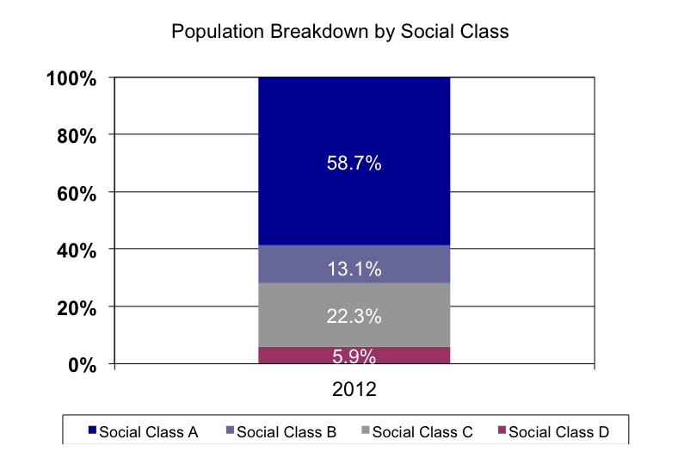
Social Classes Breakdown
Chart: % of Population by Social Class
Chart: % of Households by Earnings
Social Class A:
High Income Professionals
Social Class B:
Upper-Mid Class Professionals
Social Class C: Lower-Mid Class Professionals
Social Class D:
Poor
Source: Survey data
By international standards, the United States has the world’s largest upper class and is the world’s wealthiest large country. However, a significant segment of the population also lives in serious poverty, although this number has been reduced by 50% over the past 25 years.

Slide 37
Keys to Economic Growth in the United States
Key Factors
Consumer and Business Confidence
Economic growth rates will trend slightly upwards, but a return to 3% or greater GDP growth rates will remain elusive.
The Health of the Housing Market
High-Tech Dominance
Entrepreneurial Culture and a Growing Population
The US economy is better placed than the economies of Europe or Japan to realize significant economic growth over the next few decades. Even if these other two regions make drastic economic reforms, they will still possess major disadvantages in terms of demographics and business culture that could take decades to overcome.

Slide 38
United States: GDP Growth Outlook
Chart: GDP Growth Rates
Current Outlook:
Economic growth over the past two decades has averaged 2%, higher than that of most other developed economies, but lower than the US’ growth rates in previous decades.
After a recession in 2020 resulting from the Covid-19 pandemic, the US economy roared back in 2021.
Future Outlook:
The United States is forecast to enjoy one of the strongest economic recoveries from the Covid-19 pandemic of any country in the world.
In the longer-run, the US economy will grow at a relatively steady pace, but growth will struggle to rise to the levels of previous decades.
Source: ISA Economic Forecasts, national statistics

Slide 39
United States: Long-Term Economic Outlook
Summary
Charts: Long-Term Economic Growth
Economic growth rates in the United States have been trending downwards in the United States in recent decades.
In the 1980s and the 1990s, the US economy expanded by a little more than 3% per year.
In the 2000s and the 2010s, this growth slowed to a little more than 2% per year.
While these growth rates are low by US historical standards, they were higher than those of most other developed economies during those periods.
Looking ahead, the US economy is forecast to slow slightly, although the slowdown will not be as severe as some fear.
Some of this will depend upon the demographic situation in the United States, as its working-age population is still forecast to grow in the years head.
Meanwhile, the US’ strong position in high-tech, high-growth sectors of the economy will be a key driver of economic growth in the coming decades.

Slide 40
United States: Key Economic Sector The Automotive Industry
Summary:
The US automotive industry has been transformed by Asian competition.
The “Big 3” (GM, Ford and Fiat-Chrysler) have been losing market share to their Asian competitors since the 1970s.
Toyota, Honda, Nissan and other Asian-based manufacturers now have a major manufacturing presence in the United States, mostly in the south-eastern part of the country.
The United States automotive market is unique in terms of products and driving.
SUVs and pick-up trucks are essential to any automakers presence in the country as the US has wide roads with little need to worry about parking space.
Outlook:
Source: OICA
The US automotive industry has staged a recovery in recent years, but a number of trends could jeopardize future growth.
New technologies and changing attitudes towards driving signal massive changes ahead for the industry, but US producers may be better-placed than their rivals to meet these challenges.

Slide 41
United States: Industrial Production Growth Outlook
Chart: Industrial Production Growth Rates
Current Outlook:
Industrial production levels have struggled to bounce back in recent years.
A stronger dollar and inconsistent demand in key markets prevented industrial output from rising as high as had been hoped in previous years.
Supply chain disruptions in 2021 also prevented industrial production growth from rising as much as had been hoped for.
Future Outlook:
Industrial sectors of the US economy will struggle to generate growth over the near-term due to lingering supply chain disruptions, the country’s trade disputes and weakened global demand over the longer-term.
Improving export demand and the US’ strong position in many high-tech manufacturing sectors could give the country’s industrial output a significant boost over the longer-term.
Source: ISA Economic Forecasts, national statistics

Slide 42
United States: Inflation Outlook
Chart: Inflation Rates
Current Outlook:
Inflationary pressures eased in previous years, coinciding with the downturn for the US economy.
In recent months, inflationary pressures in the United States rose to their highest levels in recent years, driven upwards by the surge of government money into the US economy.
Future Outlook:
Inflation rates are forecast to remain relatively high over the near-term, but a major increase in inflationary pressures is unlikely.
Source: ISA Economic Forecasts, national statistics

Slide 43
United States: Foreign Trade Overview
Chart: Leading Trade Partners
Chart: Current Account Balance
Source: ISA Economic Forecasts, national statistics
The United States’ global trade relations are dominated by four partners (Canada, Mexico, China and the European Union). In recent years, the US’ trade and current account deficits have trended upwards, reflecting the strong demand in place in the US when compared with most of the country’s leading trading partners.

Slide 44
United States: Foreign Investment
Chart: FDI Inflows
Foreign Investment Climate:
The United States remains the world’s leading recipient of foreign investment by a healthy margin.
Foreign investment peaked in 2015 and 2016, both sliding back in recent years.
The vast potential of the US market, combined with its continued expansion (unlike other developed markets), will continue to attract foreign investment.
This growth will accelerate in the coming years as foreign investment levels begin to rise again.
Furthermore, the United States is easily the leading recipient of foreign investment in a variety of high-technology sectors.
Outlook For Future Foreign Investment:
The vast US market, combined with the US’ lead in many high-tech industries, will continue to attract foreign investment to the United States.
Moreover, the overall attractiveness of the US economy remains relatively high.
This alone will be enough to keep the US at or near the top of the foreign investment tables.
Source: UNCTAD

Slide 45
Foreign Investment in NAFTA
Source: UNCTAD
The United States has been the largest recipient of foreign investment over the past decade, and FDI inflows soared prior to their recent slump. Meanwhile, Canada and Mexico have experienced a slowdown in FDI inflows, as uncertainty over their trade relationship with the US has hindered investment.

Slide 46
United States: Exchange Rates
Chart: Exchange Rate with the US Dollar
Chart: Exchange Rate with the Euro
Source: ISA Economic Forecasts, OANDA
Source: ISA Economic Forecasts, OANDA
The dollar was remarkably strong against most other major currencies between 2014 and 2019 due to the dollar’s status as a safe haven currency. In 2020, the dollar finally weakened, but rebounded again in 2021. Looking ahead, the dollar is expected to remain relatively strong over the course of the forecast period.

Slide 47
United States: Labor Force
Chart: Unemployment Rate
Labor Force Overview:
The flexibility of the United States’ workforce is one of the great advantages of the US economy.
No workforce in the developed world is as willing to move around their country when it is advantageous for their employment.
Employers have an easier time hiring and releasing employees than in other developed economies.
Unemployment rates had fallen significantly in previous years thanks to high job creation levels.
In fact, both before and after the Covid-19 crisis, labor shortages have impacted many sectors of the US economy, holding back growth in those sectors.
Outlook For the Labor Force:
Source: ISA Economic Forecasts, OANDA
Unlike nearly all other developed countries, the US’ workforce will continue to expand in the coming years, giving the US economy significantly more potential for growth over the longer-term.
Meanwhile, the US’ unemployment rate will continue to trend downwards in the coming years.

Slide 48
Fiscal Policy Overview
Chart: Fiscal Balance
Current Outlook:
The government was able to reduce its budget deficit at a faster pace than had been expected, with the deficit hovering around 4% of GDP in recent years.
The US’ fiscal deficit soared in 2020 due to the impact of the government stimulus measures during the Covid-19 pandemic on the government’s finances, rising to levels last seen in the Second World War.
Future Outlook:
While the near-term outlook for the fiscal deficit is very poor, a number of long-term issues also remain unresolved, and these could lead to more significant increases in budgetary pressures in the decades ahead.
Source: ISA Economic Forecasts, OANDA

Slide 49
Largest Companies in United States
Leading Companies:
The US is home to more of the world’s largest companies than any other country.
Wal-Mart, in terms of revenues, is the world’s largest company by a wide margin.
Moreover, US firms have a large presence in all global markets.
The leading position of traditional US manufacturing companies is being challenged by fast-growing new technology and services companies.
Many of the largest companies in terms of market capitalization and profits are these relative newcomers.
Source: Forbes
Outlook for Domestic Companies:
US-based multinationals are among the world’s most powerful companies and they exert a great deal of influence over both the domestic and international economies.
Given the US’ lead in fast-growing high-tech and medical sectors, US firms will likely continue to make up a large proportion of the world’s largest companies.

Slide 50
United States Regional Economies
The US is characterized by a number of significant regional economies, although no clear boundaries exist due to the easy relocation of operations and personnel. With a continued population shift to the south and the west, these regions have seen the most economic growth in recent decades.
The industrial heartland of the US in undergoing a major transformation as new industries grow.
Many service industries are based in the corridor stretching from Boston to Washington.
The western US is the center of many of the world’s cutting-edge industries.
The Southeast is a major center of foreign investment due to low costs and a high quality of living.

Slide 51
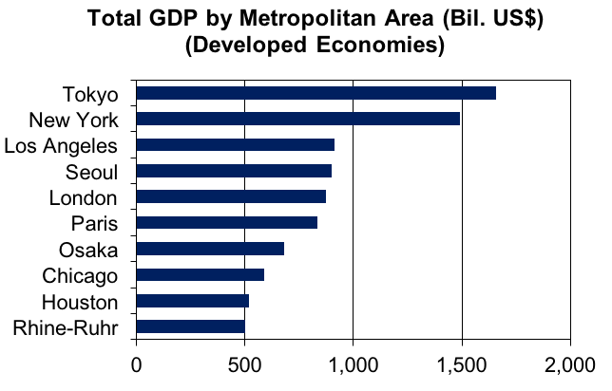
City Economies
World’s Largest City Economies
The Development of Local Economies
The United States is home to many of the world’s large metropolitan area economies.
The economies of New York and Tokyo dwarf those of all other cities.
Cities in the south and the west of the United States have seen their economies grow rapidly.
Thanks to high rates of population and economic growth, US cities will remain among the largest city economies in the world, although they will face challengers, most of whom will be based in emerging markets.

Slide 52
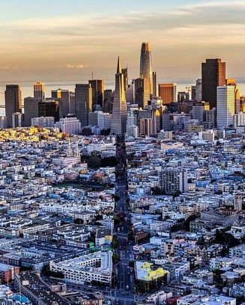
Issue in Focus (part one): What the United States Does Well, and Where it Needs to Improve
Introduction - No country’s strengths and weaknesses are more analyzed and critiqued than that of the United States. This is due mostly to the immense power and global reach possessed by the United States and its pre-eminent position in global affairs over the past century. For former great powers, opinions of the United States range from jealousy at the US’ current power to disdain for its use of this power on the global stage. For countries that aspire to become great powers themselves one day, opinions of the United States run the gamut from admiration of the immense power that the US possesses to anger at the US’ role in preventing other powers from challenging its position. Meanwhile, it is clear that many countries in the world can learn much from the United States’ rise to become the world’s leading power. However, it is also true that the US can also still learn much from the world, much as it did when it rose to great power status in the first place.
The US Economy
The obvious place to start when assessing what the United States does well, and what it needs to do better, is the economy. Today, the US is the world’s largest economy, with a total economic output that exceeds $20 trillion. It became the largest economy in world history by doing many things well. Among the strengths of the US economy are its ability to generate vast sums of wealth and to continue to grow at a pace that exceeds that of most other wealthy economies. In addition, the US economy is the world’s most modern and diverse economy, with the US possessing a leading position in most of the world’s high-tech and high-growth industries and services. Meanwhile, the US economy benefits from the world’s most advanced financial sector as well as from the relative ease of doing business in that country. Still, there are some areas of the US economy that need to be improved. For example, wealth inequality has risen to dangerously high levels in the US in recent years, and while the US has been able to reduce such inequality in the past, there is no guarantee that it can do so in the modern era. Meanwhile, rising costs, most notably in the healthcare sector, are another area in which the US economy needs to improve. Finally, the US needs to maintain the momentum that has produced its leading position in many high-tech and high-growth sectors in order to retain its leading economic position.
The American Dream
One aspect of the United States that is closely monitored by the rest of the world is the country’s living standards. For many, the US continues to represent the “American Dream”, a land in which anyone who is willing to work hard or generate good ideas can enjoy unmatched success. In fact, the US does enjoy many advantages when it comes to living standards. For example, the average person in the US owns more land and has larger homes than most of their counterparts elsewhere in the world. Furthermore, average wages and disposable income in the United States are among the highest in the world, and continue to attract highly-skilled people to the US. Despite these major advantages, some aspects of living standards in the United States are in need of improvement. however. For example, health standards in the US trail behind many countries that enjoy far lower levels of economic development than the US. Likewise, social programs and safety nets for disadvantaged individuals are much smaller in the US than in many other countries. Finally, some minority groups in the United States enjoy much lower standards of living than others, fueling racial tensions in the US and adding to the rising level of inequality there.

Slide 53
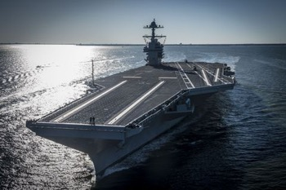
Issue in Focus (part two): What the United States Does Well, and Where it Needs to Improve
US Politics
Perhaps no aspect of the United States today garners more attention from the wider world that its politics. For much of the US’ history, its political system has proven to be a strength, allowing the country to come through tumultuous times seemingly unhindered as it progressed to global power status. Today, few view the United States’ political situation as an advantage, although thus far, the US political system has proven highly resilient. For many, the United States’ constitution provides both the backbone of the US’ political strength, as well as its greatest hindrance to adopting to the changes of the modern world. Meanwhile, the US has long been divided politically, with some periods of its history being characterized by deep political divisions. However, it is generally believed that the divisions that exist today are wider than those at any time in recent decades. These divisions can be found in many areas, including by ideology as well as by region. Meanwhile, there are fears that as these divisions widen, less qualified candidates and leaders are gaining positions of political power in the US, something that could jeopardize the US’ position of global leadership.
US Military Power
One area in which the rest of the world looks to the United States as the unquestioned leader is security and defense. In fact, since the end of the Cold War, the US has dominated global security and defense unlike any power in history. Today, the United States’ armed forces are widely considered to be the most powerful in the world by a large margin, particularly at sea, where the US Navy dominates the world’s oceans. Other aspects of US security and defense that are admired by much of the world are its alliances with other significant military powers as well as the security afforded the US by its advantageous geographic position. Where the US’ security and defense has been criticized has often been for the vast expenses needed to give the US its advantages in these areas and the potential for overreach stemming from US commitments in many far-flung parts of the world. In addition, the US has come in for criticism for its involvement in conflicts in many areas of the world, conflicts that would seem to provide few significant benefits for US power and security.
Technology
Another area in which the United States has played a leading role for a long time is in technological development. In recent decades, the United States has been the leading driver of technological advancement in a wide variety of fields. However, the US is now facing new challengers in many fields, including one of from China, the only competitor that can match the US in terms of scale as well as the potential for developing new technologies. At the moment, the US has a leading position in most high-tech industries and this has played a key role in the ability of the US to realize higher rates of economic growth than other developed economies. Likewise, the US’ domination of the IT sector has allowed the US to play a role akin to that of the United Kingdom during the early decades of the Industrial Revolution. Nevertheless, the United States must not rest on its laurels, as Asian rivals are investing heavily in many high-tech industries and could challenge the US’ position of leadership in many high-tech sectors in the coming years. Furthermore, the willingness to adopt new technologies must remain high among US consumers if this is to remain an area of strength for the US in the future.

Slide 54

Issue in Focus (part three): What the United States Does Well, and Where it Needs to Improve
The Environment
With regards to the environment, the United States is in some cases widely admired and in others widely vilified. On the positive side, the United States is a vast country with a more diverse topography, flora and fauna than perhaps any other country on earth. Moreover, the United States has done more than nearly any other country to protect vast areas of its territory and to allow nature to flourish in these protected areas. Meanwhile, many US states and municipalities are among the more environmentally-progressive places in the world. On the negative side, the United States remains a major polluter, with high carbon emissions and a relatively poor level of recycling. Furthermore, changes in the national government often lead to dramatic changes in environmental policy on the national level. Going forward, the US has the potential to play the leading role in improving the health of the world’s environment, but it is far from certain that it is willing to play this role, something that both frustrates and angers its international partners.
Demographic Advantages Waning?
For much of its history, the United States benefitted from major demographic and social advantages, some of which persist to this day. As the world’s third-most-populous country, the US is home to a wealthy, diverse and growing market, something that has driven its economic expansion. Furthermore, the US has done better than any other country in history in terms of attracting high-skilled talent. At the same time, the US’ diverse population has given the country a rich culture whose influence has spread to most corners of the globe. However, some aspects of the US’ demographic and social situation are becoming a cause for concern. For example, the United States’ birth rate has fallen sharply in recent decades and is approaching the levels seen in Europe and East Asia. Another example is the fact that violent crime remains a major problem thanks to high levels of wealth inequality and the huge numbers of guns in circulation in the US. Minority relations also remain a challenge for the United States, both in terms of minorities that have been in place for centuries as well as with regards to the changing immigration trends facing the US in the 21st century.

Slide 55

Issue in Focus (part four): What the United States Does Well, and Where it Needs to Improve
US Culture
Culturally, the United States has had a massive impact on the world for more than a century. In fact, the US, whether through its film, music, literature or other aspects of its culture, has been the source of much of the culture that is dominant in the world today. Moreover, cultural trends that begin in the US typically spread around the world at an ever-faster speed thanks to modern communications. Furthermore, the fact that the United States speaks English and has succeeded the United Kingdom as the world’s leading power, has allowed the English language to grow into the world’s dominant language, something that clearly benefits the US and other English-speaking countries. For some, this has resulted in a sort of cultural imperialism, in which US culture, or derivatives of US culture, come to dominant and eliminate other cultures around the world. In fact, this has led to a backlash against US cultural influence in many areas of the world.
Open for Ideas
Without question, the United States will remain the world’s most influential country for a long time to come. For many, the US will remain a beacon of hope and an example to be followed. However, the United States must also overcome a myriad of challenges if it is to remain both the world’s leading power and a country that influences the rest of the world. Furthermore, the United States can, and should, learn from others when it comes to the challenges that it faces, and the weaknesses that prevent the US from being even more powerful and influential. It is important for policymakers in the United States to remember that, for much of its history, the US was open to ideas from other countries, and it was this openness that allowed the US to become such a great power in the first place. History shows us that, when a great power turns inward and closes itself to ideas from outside its borders, that power eventually withers. As such, now is not the time for the US to turn inwards, but to remain the country that earns the respect and admiration of its peers around the world.

Slide 56
Issue in Focus (part five): What the United States Does Well, and Where it Needs to Improve

Slide 57
Forecast Assumptions and Risk
Assumptions:
Risks:
The Lingering Impact of the Covid-19 Pandemic
With new variants likely and vaccination rates either stagnating or rising too slowly, the Covid-19 pandemic will continue to cause periodic disruptions to many economies in the coming months.
Supply Chain Disruptions Persist
The supply chain disruptions that have badly impacted many sectors of the global economy could persist for a longer period of time than is expected, further slowing economic growth.
The Global Economic Recovery Continues
The global economy will continue to recover from the impact of the Covid-19 pandemic, but this recovery will gradually lose momentum, reducing economic growth rates to pre-pandemic levels.
Inflationary Pressures Persist
While deflationary pressures remain the greater threat for many key economies over the long-term, inflationary pressures could rise further over the near-term, threatening to slow economic growth.
US-China Divisions Widen
The political and economic divisions between the world’s two superpowers will continue to widen, forcing many countries and businesses to balance their relations with each country.
Geopolitical Tensions Worsen
Major geopolitical threats such as the deteriorating relationship between the US and China and the growing risk of conflict in many areas of the world could dramatically raise geopolitical risk levels.
Political Divisions Remain
The dramatic polarization of US politics in recent years will be disappear in the coming years as both of the country’s leading political parties become more entrenched on key policies.
Loss of Skilled Immigration
Efforts to reduce the level of immigration into the United States could have the side-effect of reducing the inflow of highly-skilled, highly-educated immigrants, to the detriment of the US economy.

Slide 58
United States: Economic Risk Outlook
Current Economic Risk Ratings:
Economic Risk Outlook:
Economic risk levels had trended downwards in previous years from their peak in the wake of the recent financial crisis.
However, the Covid-19 crisis led to a sharp increase in economic risk levels in the United States, as did the subsequent issues concerning inflation, labor shortages and supply chain disruptions.
Nevertheless, the United States has lower levels of economic risk than just about any other large developed economy.
Low Risk………………High Risk
ISA Risk Ratings
0.0 to 1.9 = Low Risk
2.0 to 3.9 = Low to Moderate Risk
4.0 to 5.9 = Moderate Risk
6.0 to 7.9 = Moderate to High Risk
8.0 to 10 = High Risk

Slide 59
United States Demographic and Environmental Outlook

Slide 60
United States: Population Overview
Chart: Total Population
Chart: Working-Age Population
Source: UN
The United States is easily the most populous country in the developed world. Moreover, unlike Europe and Japan, which face a major demographic downturn, the US population continues to grow due to immigration and a slightly higher birth rate. However, the US’ birth rate has trended downwards over the past decade.

Slide 61
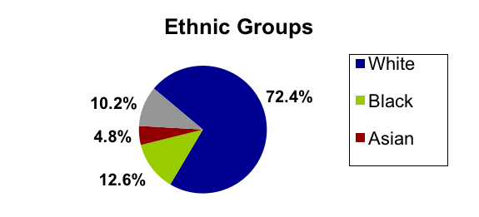
Composition of United States' Population
The white population of the United States remains predominant, but its share of the population continues to fall.
Hispanics (here classified white or black), have become the largest minority in the US and their share continues to grow.
Asians are another fast growing minority in the US.
The United States’ global influence has allowed English to become the world’s dominant language.
Within the United States, a number of regional dialects of English are spoken.
Spanish usage is also growing along with the size of the country’s larger Hispanic minority.
The United States has the world’s largest Protestant population.
No single Protestant denomination is predominant in the US.
The Roman Catholic population in the US is growing along with the Hispanic population, and the US now has the world’s third-largest Catholic population.
Sizeable Muslim and Jewish communities also exist in the US.

Slide 62
North America Population Trends by Country
Source: US Census Bureau
Source: US Census Bureau
The United States will account for more than half of the region’s population growth before the middle of this century as emigration from other North American countries contributes to this expansion. Mexico and Guatemala will also see significant population growth, even with high rates of emigration.

Slide 63
The Population Boom in the Western United States
Source: US Census Bureau
The Western United States continues to experience the highest rates of population growth in the developed world, with all major cities in the region expanding rapidly in recent decades.
Notes:
300 million today – 650 million by 2025 - 1 billion by 2050

Slide 64
The Population Boom in the Southern United States
As in the western part of the country, the southern United States has experienced rapid population growth in recent years, mainly through an influx of people from northern and eastern areas of the country.
Notes:
300 million today – 650 million by 2025 - 1 billion by 2050

Slide 65
Slower Population Growth in the Midwestern United States
Source: US Census Bureau
Population growth in the Midwestern United States has been much lower than that in the western or southern regions of the country. Nevertheless, some cities such as Minneapolis, Indianapolis and Columbus have experienced rapid growth in recent years.
Notes:
300 million today – 650 million by 2025 - 1 billion by 2050

Slide 66
Slower Population Growth in the Northeastern United States
Source: US Census Bureau
New York City and its surroundings remain the most-heavily-populated area of the United States, but growth there is slowing. In fact, apart from the area around Washington DC, population growth in the northeastern United States is generally slower than in other areas of the country.
Notes:
300 million today – 650 million by 2025 - 1 billion by 2050

Slide 67
Key Demographic Issue in United States The Ethnic Mix
Every year, the white population decreases as a percentage of the total US population.
Meanwhile, the Hispanic population is growing at a very fast rate and Hispanics have now surpassed African-Americans as the largest minority group in the country.
The Asian population in the United States is also growing rapidly, particularly in the western US.
In contrast, the African-American population is growing at more or less the national average.
This change in the country’s ethnic mix is having a major impact in many areas of US society.
The US is become less of an “Atlantic” country, and more “Pacific” (or “Latin”).
These dynamic immigrant groups have a major impact on US culture.
Meanwhile, race relations remain a difficult subject in the United States, with many members of the country’s ethnic minority groups facing discrimination in many fields.
Source: US Census Bureau
Fears that the changing ethnic mix of the country will lead to increasing societal divides have risen in recent years, particularly among the country’s African-American minority. While the United States has largely been successful at integrating its minority groups, some segments of the population feel increasingly marginalized.

Slide 68
Demographic Implications for the Economy
The United States will add more people to its population than all other developed markets over the next few decades.
The continued expansion of the US population will allow the US to enjoy higher economic growth rates than most other developed markets.
The US, like the rest of the developed world, is experiencing major growth in the number of elderly people, but the average age remains below Europe’s or Japan’s.
Economic growth will remain strongest in the West and the South as these regions continue to receive the bulk of internal and external migration.
The US enjoys one of the world’s most favorable demographic situations in the 21st century. It’s working-age population will continue to grow, while the productive segments of society will continue to constitute a large portion of the US population.

Slide 69
United States: Topography and Climate
Topography and Climate:
Key Environmental Issues:
Topography
Few countries in the world can compare with the geographic diversity of the Unites States.
The western United States consists of highlands and mountains.
The center of the country is mostly prairies and rolling grasslands, drained by the Mississippi-Missouri river system.
The eastern US is hilly, with a coastal plain stretching far inland in places.
Climate
Perhaps no country in the world has the variety of climates that are found in the Unites States.
From the arctic climate of Alaska, to the tropical climate of South Florida and Hawaii, the US has nearly every climate found on the planet.
The driest areas of the United States are found in the southwest, while the wettest area is the Pacific Northwest, along the coast.
Perhaps no other developed country in the world still has maintained as much of its wildlife as the United States.
However, population growth threatens the habitats or many species of wildlife.
In other places, conservation has led to a dramatic increase in wildlife populations, but they must compete for space with humans.
Few developed countries are subject to as many natural disasters as the United States.
In the West, volcanoes, earthquakes, droughts and fires are fairly commonplace.
To the east, hurricanes and tornados are a frequent threat to many areas.
The United States’ urban areas cover much more ground than their counterparts in other countries.
This “urban sprawl” is the result of American’s preference for living in spacious suburbs.
Forests and other natural areas remain at risk from this trend.

Slide 70
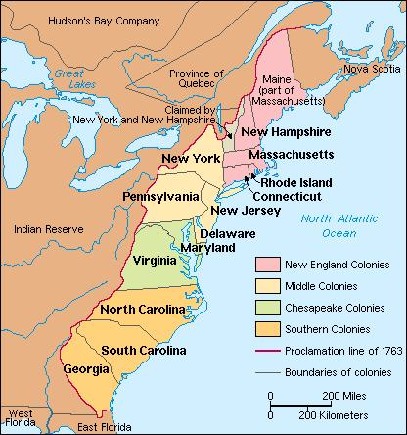
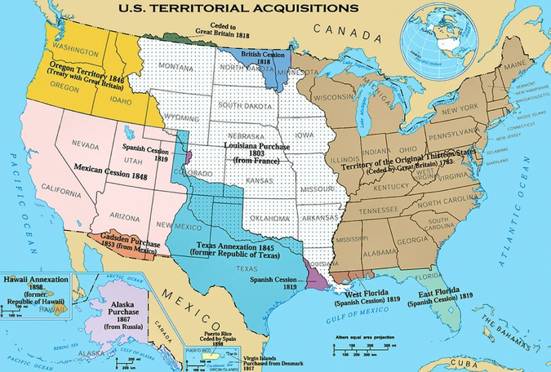
United States: Historical Maps
Map: 13 Colonies in 1775
Map: US Westward Expansion
The original 13 British colonies that would go on to form the United States were squeezed between the Atlantic Ocean and the Appalachian Mountains.
The United States quickly spread to the Pacific Coast in the West in a period of less than a 70 years after winning its independence.

Slide 71
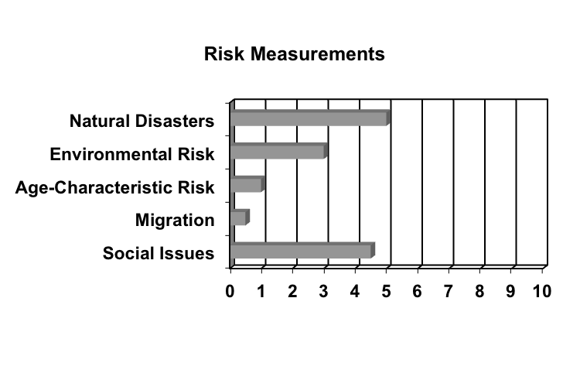
United States: Demographic and Environmental Risk Outlook
Current Risk Ratings:
Demographic Risk Outlook:
No developed country in the world faces lower-levels of demographic risk than the United States, thanks in large part to its controlled immigration.
Environmental Risk Outlook:
Low Risk………………High Risk
Despite its vast size, the United States is facing higher levels of environmental risk than ever before.
ISA Risk Ratings
0.0 to 1.9 = Low Risk
2.0 to 3.9 = Low to Moderate Risk
4.0 to 5.9 = Moderate Risk
6.0 to 7.9 = Moderate to High Risk
8.0 to 10 = High Risk

Slide 72
ISA April 2022 Country Report
United States

